Slide 1
Edge Computing: Vision and Challenges
Weisong Shi et al.

Slide 2
About the authors
Research Interests
Edge Computing, Vehicle Computing, Autonomous Driving, Mobile and Connected Health
Short Bio and Highlights
Dr. Weisong Shi is a Professor and Chair of the Department of Computer and Information Sciences at the University of Delaware (UD). Before joining UD, he was a faculty of Computer Science at Wayne State University and served in multiple administrative roles, including the Associate Dean for Research and Graduate Studies at the College of Engineering, Interim Chair of Computer Science, and Program Director of NSF. He founded the Connected and Autonomous Research Laboratory (The CAR Lab) in December 2017. He is an IEEE Fellow and a Distinguished Scientist of ACM.
Recent publications: Vehicle Computing: Vision and Challenges

Slide 3
About this paper
Published in IEEE Internet of Things Journal
Very impactful: Cited close to 6000 times (it was 3000+ two years ago)
Structure:
Definition and why we need edge computing;
Case Study
Challenges and Opportunities

Slide 4
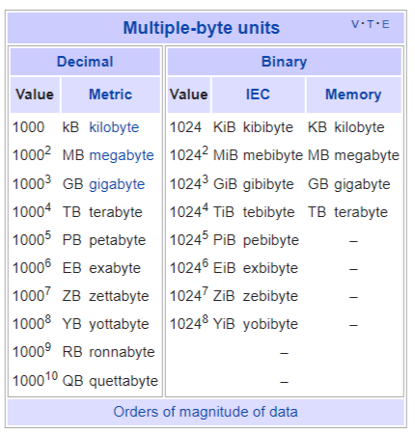
Introduction:
Why we need edge computing (a brief introduction)
Structure of this vision paper
By 2019,
data produced= 500 Zettabytes
data center IP traffic = 10.4 ZB
Is that true? no….
https://financesonline.com/how-much-data-is-created-every-day/

Slide 5
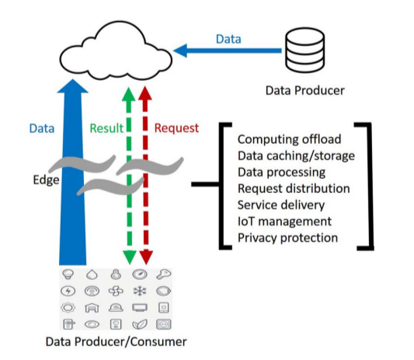
Why we need Edge Computing
Push from Cloud: bandwidth not enough for generated data; latency
Pull from IoT: more IoT devices, more data, using cloud is insufficient
Edge user’s role: data consumers ⇒ data producer
Watch video → Generate video

Slide 6
What is Edge Computing?
Here we define “edge” as any computing and network resources along the path between data sources and cloud data centers.
a smartphone is the edge between body things and cloud
a gateway in a smart home is the edge between home things and cloud
a micro data center (cloudlet) is the edge between a mobile device and cloud
edge computing focus more toward the things side, while fog computing focus more on the infrastructure side

Slide 7
Edge Computing Benefits
Latency
Energy consumption
What else?
~ reliability?
~ bandwidth usages?
~ user concerns about privacy?

Slide 8
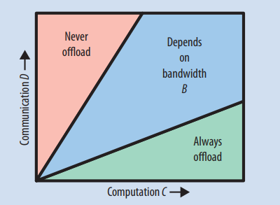
Case Study 1: Cloud Offloading
What is cloud offloading?
Mobile devices handle all the computation tasks.
Move the data to cloud: cloud handles the computation tasks.
Research on cloud offloading: Software Engineering (how to automate the offloading?)
Examples:
Online shopping cart:
Edge-based caching (multiple nodes)
Navigation (I like this!)
Video-gaming
Reference: “Cloud computing for mobile users: Can offloading computation save energy?

Slide 9
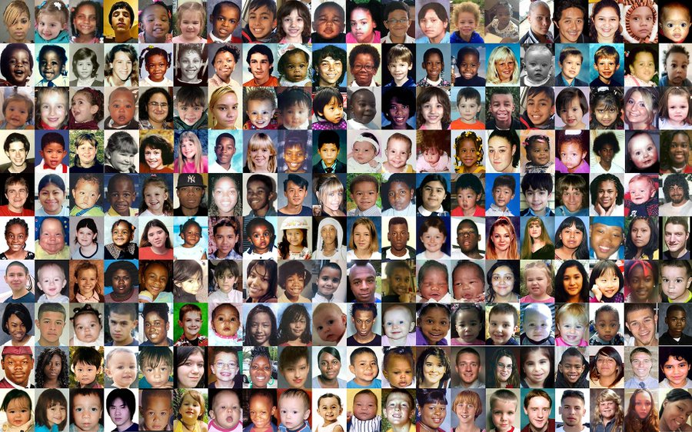
Case Study 2: Video Analytics
Finding a lost child in the city
The child’s video can be captured by all kinds of cameras owned by private parties (cars, shops, etc).
Those cameras do not upload their videos to the public cloud. (privacy, bandwidth)
Execute the search requests on the cameras locally and return the results.
Problem:
Coordination (between cameras)
Incentive (why I should contribute my resources to help you?)

Slide 10
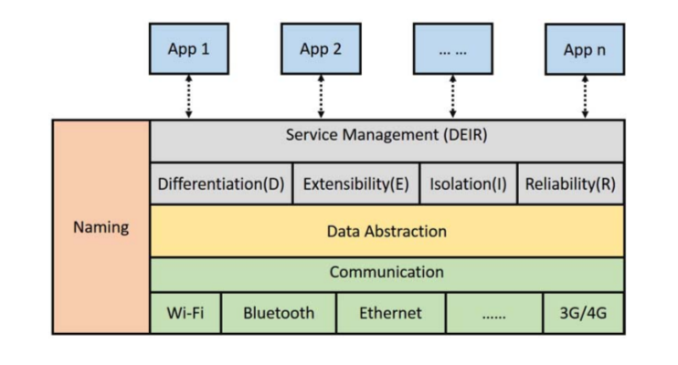
Case Study 3: Smart Home
IoT in home env:
Smart devices: smart light, smart TV, and robot vacuum
Sensors and controllers
Gateway (edgeOS) connect all the things and process data

Slide 11
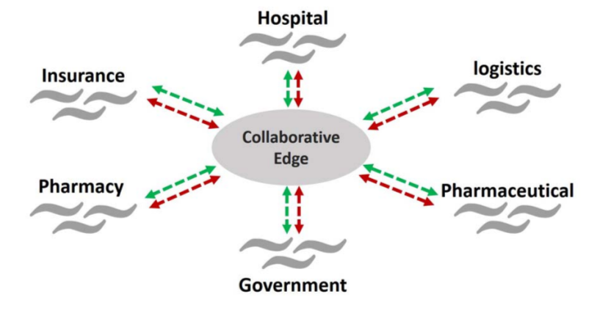
Case Study 4: Smart City & Collaborative Edge
collaboration among multiple stakeholders is limited
Cloud Computing: Upload data to public cloud ⇒ process the data and get insight
Edge Computing: download processing script to edge ⇒ upload insight to cloud

Slide 12
My two cents:
Edge computing in the author’s view vs. Edge Computing in big tech’s view
Collaborative vs. Extension of Cloud (lower latency)
Does the applications (public safety, health care, etc) really need edge computing? I don’t feel that way…

Slide 13
CHALLENGES AND OPPORTUNITIES
Programmability:
Heterogeneous edge computing platforms (with different runtime and programming interfaces) [ virtualization + portable runtime ]
Heterogeneous available resources
Computing Stream: a serial of functions/computing applied on the data along the data propagation path
By deploying a computing stream, we expect that data is computed as close as possible to the data source, and the data transmission cost can be reduced.

Slide 14
CHALLENGES AND OPPORTUNITIES
Naming: human understandable → machine operable
how to find the right device/right resources
Problem: Edge practitioners needs to learn various communication and network protocols to communicate with the heterogeneous things in apps.
Challenge: mobility of things, highly dynamic network topology, privacy and security concerns, scalability (huge number of devices), unreliable
Traditional naming mechanisms: DNS, URI (uniform resource identifier)
Too heavy for IoT devices b) don’t adapt to network dynamicity well enough
Newer naming mechanisms: NDN, MobilityFirst

Slide 15
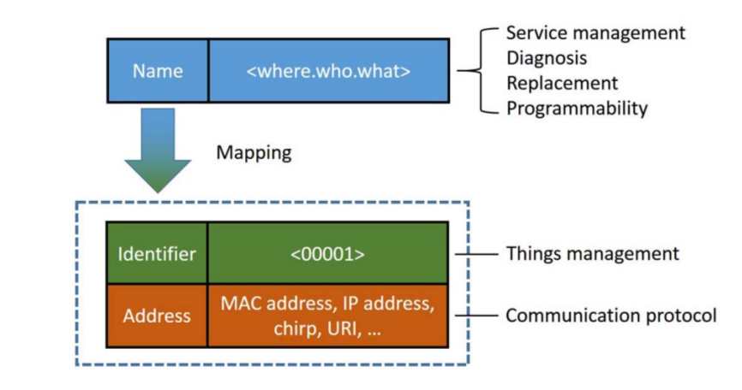
Naming mechanism in edgeOS
Naming: human → machine
kitchen.oven2.temperature3

Slide 16
CHALLENGES AND OPPORTUNITIES
Data Abstraction
Instead of providing raw data, provide meaningful (processed) data to applications
Noise outlier removal
Event detection [video footage →intrusion alert]
Privacy detection
Q: how to application developers define such data processing procedure, under:
Different data format;
Different accuracy level
Data processing + operation

Slide 17
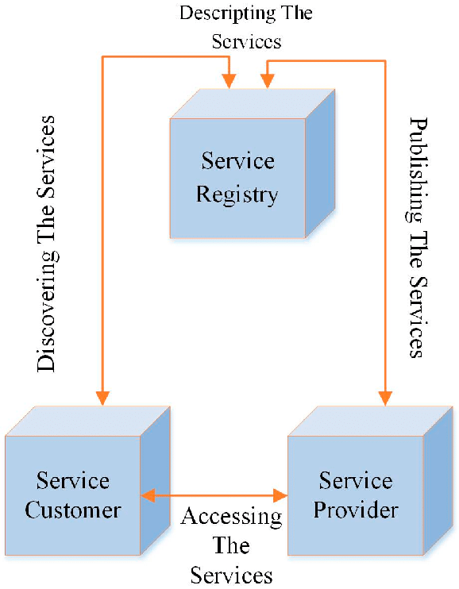
CHALLENGES AND OPPORTUNITIES
Service Management
Background: service-oriented architecture, defines a way to make software components reusable and interoperable via service interfaces. Services use common interface standards and an architectural pattern so they can be rapidly incorporated into new applications. This removes tasks from the application developer who previously redeveloped or duplicated existing functionality or had to know how to connect or provide interoperability with existing functions.
QoS: Quality of Service

Slide 18
Service Management
Differentiation: Different QoS requirements (some services are more important than others)
Extensibility: add a new thing to the system
Isolation: failure won’t propagate to the rest of the system
Reliability:
Provide action suggestion for node failure (how to fix it)
Provide function under sensor failure

Slide 19
Privacy & Security
We think that keeping the computing at the edge of data resource, which means in the home, could be a decent method to protect privacy and data security
Idea here:
Amazon/Tiktok KNOW YOU BETTER THAN YOURSELF!
How comes? it has your browsing history (cookie, session)
Why? Better Recommendation algorithm
Solution: 1) anonymization; 2) run the recommendation algorithm locally on gateway

Slide 20
Optimization
Latency: tradeoff between communication load/computation load
Bandwidth: upload less information
Energy: edge → energy free (is it true?, if we consider globally)
Cost: how to charge users / how to monitor and analysis cost

Slide 21
My two cents
Programmability:
Computing stream:
is it implemented yet?
Not on routers (CLOUDPATH)
Access points/Cell Towers (Verizon)
On self-organized sensor network (Dart)
Is is meaningful/realistics?
Why not deploy extremely powerful servers at the edge? Why deploy it on the path?
Abstract: Querying Invisible Objects: Supporting Data-Driven, Privacy-Preserving Distributed Applications

Slide 22
Comments Collected
The Video Analytics case study also doesn't really go through the resources needed in order to give proper video analytics and also is theorizing the benefits of edge computing on a larger scale but does not realize the proper resources needed for this case study to be achievable.
The paper discusses things such as smart homes and how data shouldn't be sent to cloud for privacy, so research in to how this data should be stored instead and still accessible for applications that need it would be useful.
Quantum Computing principles such as superposition and Cloning can be highly effective to be deployed in edges to reduce the latency much further and allows for faster parallel processing. Depending on computational power and memory of an edge node can be eliminated by introducing quantum edges.

Slide 23
Comments Collected
Edge computing would go the farthest when it comes to space research, given the tremendous research and development going on to setup on/communicate with other planetary objects/systems. Now, it takes approximately 24 min for an image captured at say, Mars to reach earth stations. Researchers can explore ways to minimize communication by more than 80%.
Let's say computation is performed from data and the result is sent to a local server from a remote device acting as an edge. After a considerable amount of time, can a result give the metadata of the data at the source? Given the fact that most devices used for edge tech would be remote and small-scale, there is>90% chance that data would be lost. How can data recovery be assured or developed?
Something else that seems to be neglected throughout the paper is physical security, something that naturally becomes a concern as you move data out of the cloud and closer to sources. For example, while a data center at google may be assumed to be very well secured, the local cloudlet of a city hospital may not be well secured, potentially putting important patient data at risk.

Slide 24
Comments collected
For starters, in the introduction the paper the author immediately makes a lot of assumptions based on very bold predictions about the future of data generation and consumption. Compare the current research and technology of both edge computing and cloud computing, contrast edge and cloud computing applications, and then find out where they intersect to bring effective solutions.
Though the paper focuses on the benefits of Edge Computing over the traditional approach, like reduced bandwidth usage, low latency, and possible energy saving, it ignores the potential drawbacks introduced by processing over the edge.
Limited processing power: As edge devices are generally small and have solid physical bodies, they have a finite processing power or memory, and there is a limit to which it can be improved. This restricts the type of actions that can be performed over them.
Platform dependent: As their computation power is limited, there is little flexibility regarding programming languages or OS that can be used on them.
Constantly Improving Technology: The number of IoT devices is increasing exponentially over time and getting more intelligent. But this leads to the issue of old redundant devices and a tremendous amount of E-waste that it produces.

Slide 25
Comments collected
Another point I would like to bring up is the use case of the smart home and the challenges and opportunities it presented. Where the smart home section was located made some of the content hard to grasp. It would be better to put it in the last section of the case study section and make the naming, data abstraction, and service management the three beginning sections of the challenges and opportunities section as all four sections relate to each other.
Collaborative Edge can be combined with distributed computing to limit the need for cloud use even further. Think of it as the space between the fog and the IOT. Imagine you have non-privacy sensitive but computationally high calculations to process. By using approved devices, let's say all on the same intranet - used by the same person/company - we could limit the processing needed at the cloud level. In fact we could progressively increment the number of devices being leveraged as needed. This is a suggestion to combine aspects of cloud, distributed and edge computing for optimized processing.

Slide 26
Comments collected
I find the authors definition of edge computing to be too broad. They define it as any step between an edge device and a datacenter, and expressly say that thier definition of edge computing encompases fog computing. However, I feel this scope is a little broad for the goal of the article which is promoting research. Creating such a large workspace could be too big of a goal vs a more edge focused definition. I also find the need for a new cost model to be introduced to be a little too assuming. We haven't even figured out how feasible the building of such infrastructure is for companies let alone how they will market or profit from it.
However, the paper did not seem to touch on the negatives of using edge computing over other solutions like cloud computing. Some problems I thought of that could have been talked about more include not having the cloud computing processing power and needing to use your own hardware to set up the network.

Slide 27
Comments collected
In addition, to further develop the research work, the various mentioned properties of edge computing such as location awareness, collaborative computation in multiple domains, heterogeneity of resources, etc. along with the service monitoring and management to better utilize computation power, resources, and network bandwidth can be further studied with experiments and results.
The part of the paper that piqued my interest was the case study about a smart city. There are many avenues to expand on the topic of a smart city, but it seems like self-driving cars would benefit greatly from it. Sensors on road signs, traffic lights, and even traffic comes could get information to the car much more effectively than a car's camera deciphering its own video, saving processing space and time for other variables on the road.
Edge computing may not have developed as rapidly due to economic reasons that was pointed out in the article. While the paper lists that can reduce latency, the hardware cost to increase processing power may drive up price exponentially more and thus make less sales with lower profit margins.

Slide 28
